Slide 1

Apregoar
Update 29 julho 2022
Localization of
incidents within a community
Callie Wentling
Professor Marco Painho
Professor Hugo Martins

Slide 2
Overview
Motivation
Data
Corpora
External Gazetteer
Internal Gazetteer
Data Model
Application
Setup
Publish
Contextualize
Explore
Manage
Report
Outline
Status
Next steps

Slide 3
Motivation
Is there value in integrating a spatial component to news databases?
The association of place will provide a new dimension of understanding of incident distribution at a local level.
Discovery for users
Context to journal readers
Tool for researchers
Contribute to geointelligence of the area
Publishers integrating spatial news may provide an improved user experience to readers, expand readership, and better manage spatial, temporal, and thematic coverage of stories.

Slide 4




Data: Corpora
Jan - March 2022
CML Notícias
Stories: 92
Instances: 123
Facebook posts
Stories: 39
Instances: 45
*Yet incomplete for Q1
Online Journal
Stories: 143
Instances: 360
Freguesia Notícias
Stories: 4
Instances: 5
Attribute | CML | JFC | JFCdO | Mensagem
Title | Yes | Maybe | Yes | Yes
Summary | No | No | Maybe | Maybe
Publish date | Yes | Yes | Yes | Yes
Section(s) | Yes | No | Yes | Yes
Tags | Yes | No | No | No
Author | No | No | No | Yes
Link | Yes | Yes | Yes | Yes

Slide 5
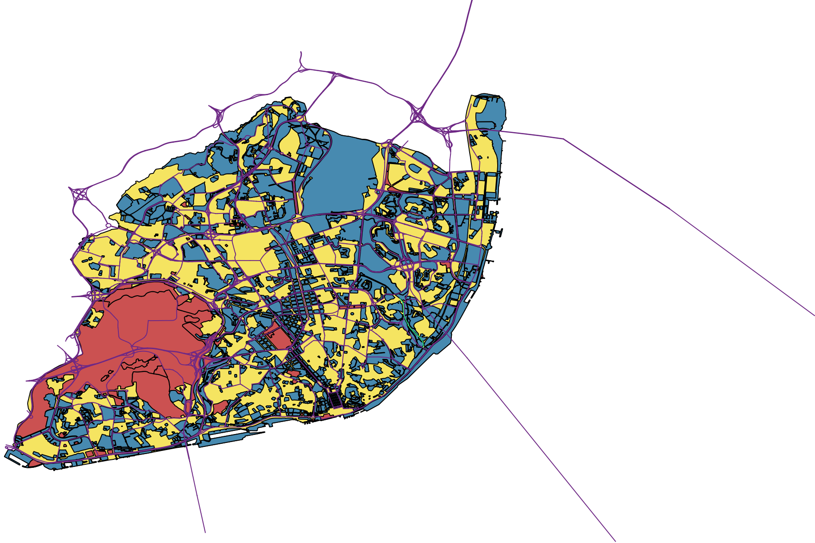

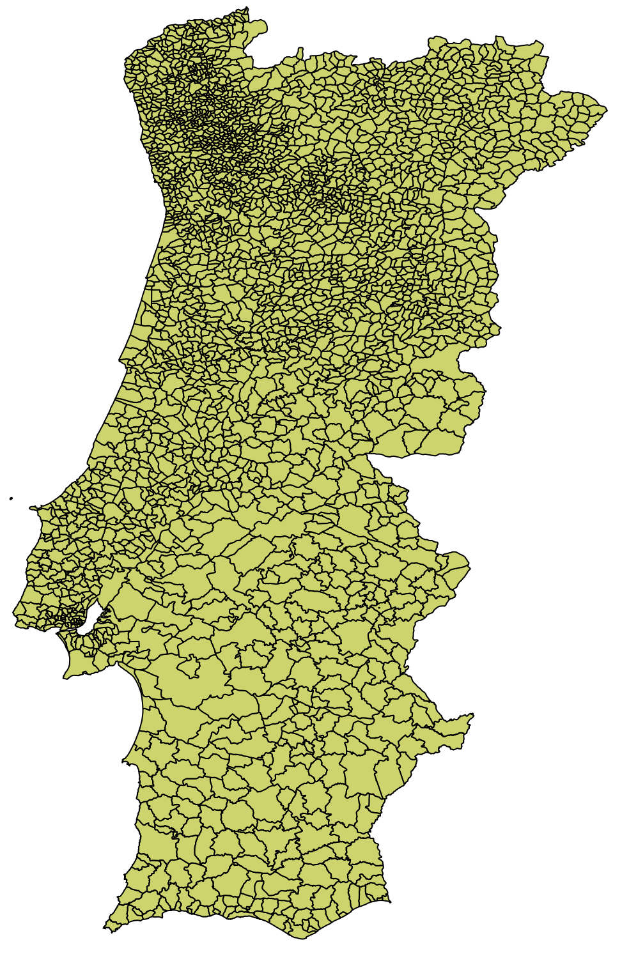

Data: Gazetteers
Source | Name | # Original | # Loaded | Transformation | Geo | EPSG
DG Território | CAOP 2019 |  | 528 | Unioned polygons, at freguesia, municipality, distrito levels, and national (continental) areas, created AML area, transformed to 4326 | Area | 3763
DG Território | CAOP 2017 |  | 191 | “ ” | Area | 3763
CML Geodados | Grande Parques | 195 | 195 | - | Area | 4326
CML Geodados | Ambiente DMEVAE | 3456 | 3456 | - | Area | 4326
Geonames | PT (5 apr 2022) |  | 3786 | Intersection with Lisbon study area | Point | 4326
Study area of Lisbon
Distrito de Lisboa ∪ Área Metropolitana de Lisboa.

Slide 6
Methodology: Toolset
Web App
Spatial data backend: PostGIS, PostGreSQL
GeoNode: GeoServer
Client Libraries: Open Layers
Language: Python, SQL, Javascript
WSGI Server
Notes:
This is the current working data model. The items in red are expected to be provided by the news data sources.

Slide 7
















Methodology: System Architecture
Presentation
Static files
Client
Data Storage
Data Access
Web App
Notes:
This is the current working data model. The items in red are expected to be provided by the news data sources.

Slide 8



Methodology: System Architecture
Data Tier
Web Tier
Basemaps
Gazetteers
Client Tier
Client
Web App
Notes:
This is the current working data model. The items in red are expected to be provided by the news data sources.

Slide 9
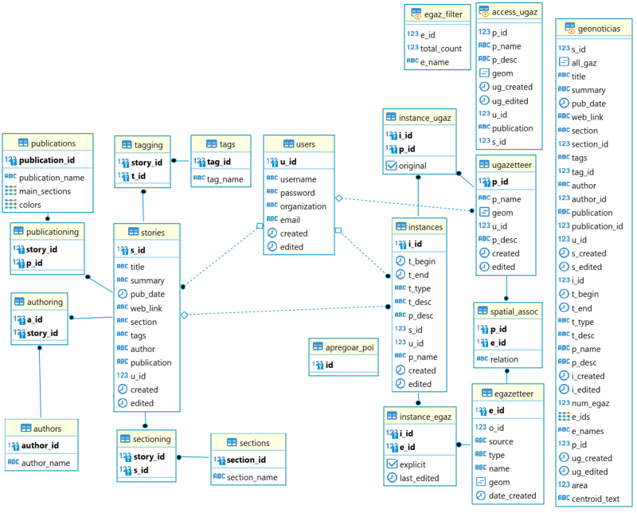
Methodology: Data model
Notes:
This is the current working data model. The items in red are expected to be provided by the news data sources.

Slide 10




Methodology: Data model
LEGEND
UGAZETTEER
SPATIAL_ASSOC
SECTIONS
1:N
p_id
geom
u_id
p_desc
created
edited
p_id
e_id
relation
section_id
section_name
123
123
123
123
ABC
123
ABC
SECTIONING
USERS
ABC
story_id
s_id
123
u_id
username
password
organization
email
created
edited
123
123
ABC
INSTANCE_UGAZ
PUBLICATIONS
ABC
publication_id
publication_name
main_sections
colors
i_id
p_id
original
123
ABC
123
NGAZETTEER
INSTANCE_UGAZ
ABC
123
ABC
n_id
geom
name
osm_id
[‘,’]
i_id
p_id
original
123
[‘,’]
123
PUBLICATIONING
123
ABC
ABC
story_id
p_id
123
INSTANCES
123
i_id
t_begin
t_end
t_type
t_desc
p_desc
s_id
u_id
p_name
created
edited
INSTANCE_NGAZ
TAGS
123
tag_id
tag_name
STORIES
i_id
n_id
123
123
ABC
s_id
title
summary
pub_date
web_link
u_id
created
edited
123
EGAZETTEER
TAGGING
123
ABC
ABC
e_id
o_id
source
type
name
geom
date_created
ABC
123
story_id
t_id
ABC
123
ABC
INSTANCE_EGAZ
123
123
ABC
123
ABC
AUTHORS
ABC
i_id
e_id
explicit
last_edited
123
123
ABC
123
ABC
ABC
author_id
author_name
ABC
123
ABC
AUTHORING
story_id
t_id
123
123
Notes:
This is the current working data model. The items in red are expected to be provided by the news data sources.

Slide 11
Methodology: Queries
GEONOTICIAS
ACCESS_UGAZ
story
instance
gazetteer
p_id
p_name
p_desc
geom
ug_created
ug_edited
u_id
publication
s_id
123
s_id
title
summary
pub_date
web_link
u_id
s_created
s_edited
section
section _id
tags
tag_id
author
author_id
publication
publication_id
123
123
ABC
123
i_id
t_begin
t_end
t_type
t_desc
p_name
p_desc
i_created
i_edited
num_egaz
e_ids
e_names
p_id
ug_created
ug_edited
area
centroid_text
all_gaz
ABC
[‘,’]
ABC
ABC
ABC
ABC
ABC
123
ABC
ABC
123
ABC
123
ABC
123
ABC
ABC
123
ABC
123
ABC
123
EGAZ_FILTER
ABC
123
e_id
total_count
e_name
123
ABC
ABC
123
123
Notes:
This is the current working data model. The items in red are expected to be provided by the news data sources.

Slide 12
Methodology: Process
Corpora
Context Tool
Geo-Corpora DB
Publish Tool
Explore Tool
Export /
Connect
Dashboard Tool
Gazetteer
Notes:
This is the current working data model. The items in red are expected to be provided by the news data sources.

Slide 13
Tools: Publish
Create
Story attributes
Extract & save new geometries
Spatially relate geom w gaz
Link exists in DB?
Extract & save datetime, text
Associate existing geometries
Distribute As into tables in DB
Validate user input
Load stories created by user
Localize
Instance attributes
Viz tool
Load gazetteers for association
WMS layer,
WFS popups
Notes:
This is the current working data model. The items in red are expected to be provided by the news data sources.

Slide 14
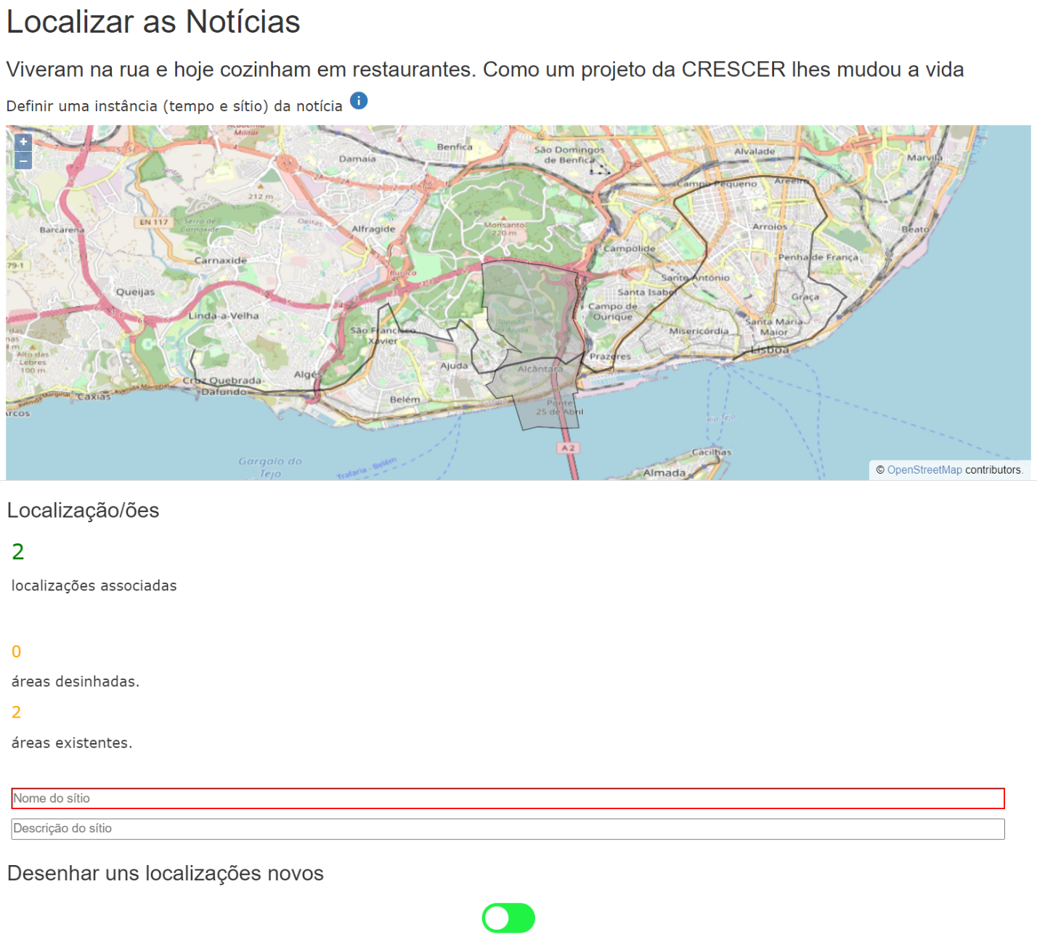
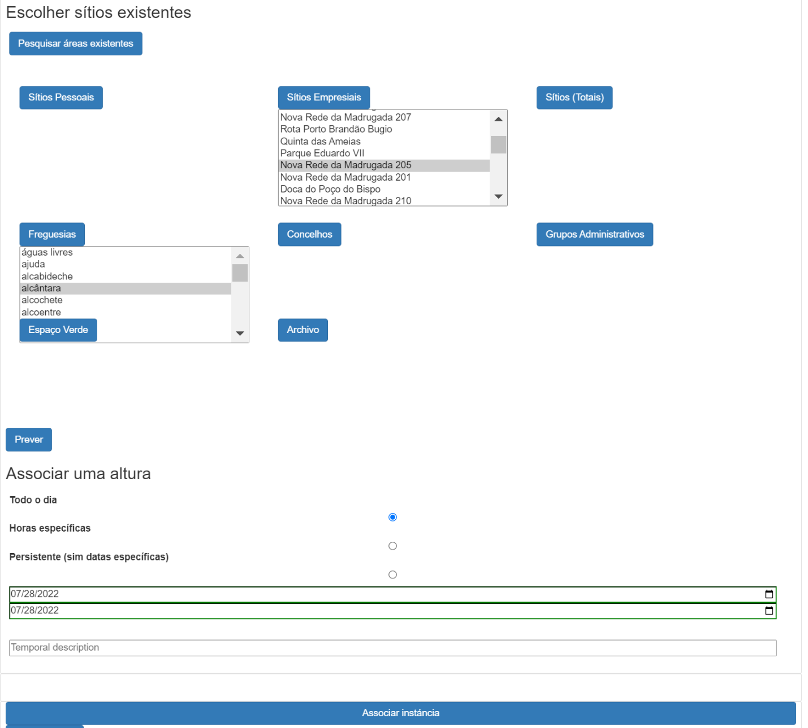
Tools: Publish

Slide 15
Tools: Explore
Load explore
Apply “spatial_assoc” relation
If inst date range, desc
If ptype
If admin filter
Apply
Filter
Load options for thematic attr’s
If ptype sem def
Python
True
False
JS
Determine & apply spatial function
Load date ranges of stories, inst’s
Include stories w/o inst
If custom search area
If pubdate ,thematic
Package as JSON
Base query of instances
Parse JSON response
Apply
If instance
If search:
Load recent results
Filters selected
WFS to Geoserver Geonoticias
Find matches in any/all text attributes
Parse JSON and set filter options
Explore Map
Updat results list and map layers
Prepare results and package as JSON
Notes:
This is the current working data model. The items in red are expected to be provided by the news data sources.

Slide 16
Tools: Explore
Python
True
False
JS
Explore Map
Click map feature
Click inst item
Click story item
Popups w details of all loaded inst at click point
Brightlight inst feature + popup details
Highlight all inst features of story
Load details of story + brightlight selected inst
Clink link
Notes:
This is the current working data model. The items in red are expected to be provided by the news data sources.

Slide 17
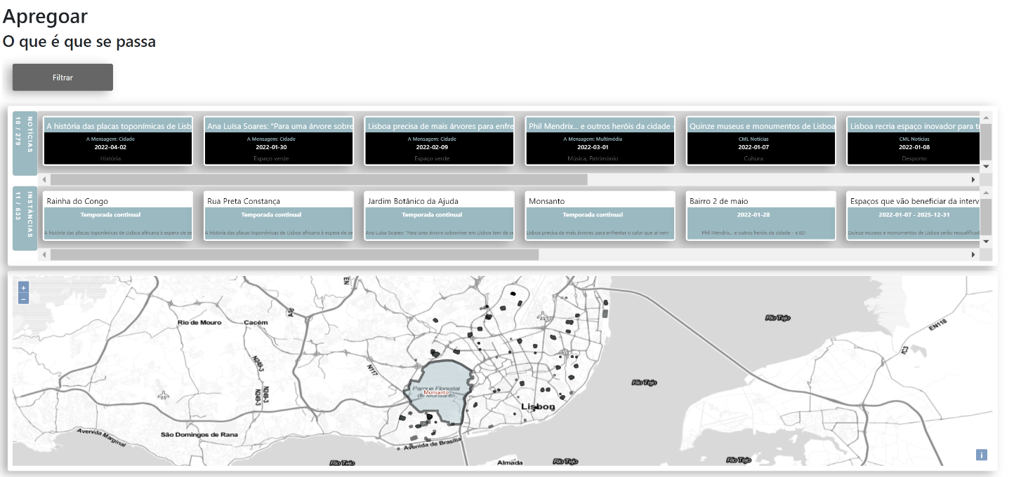
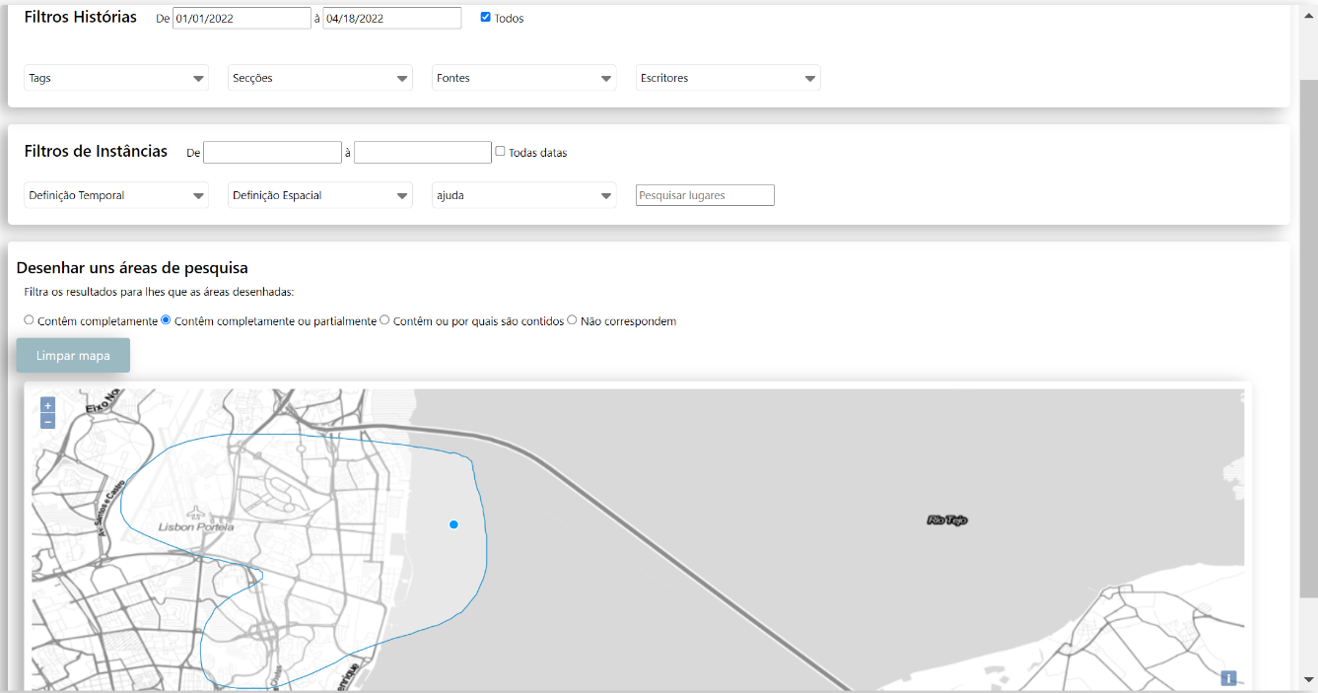
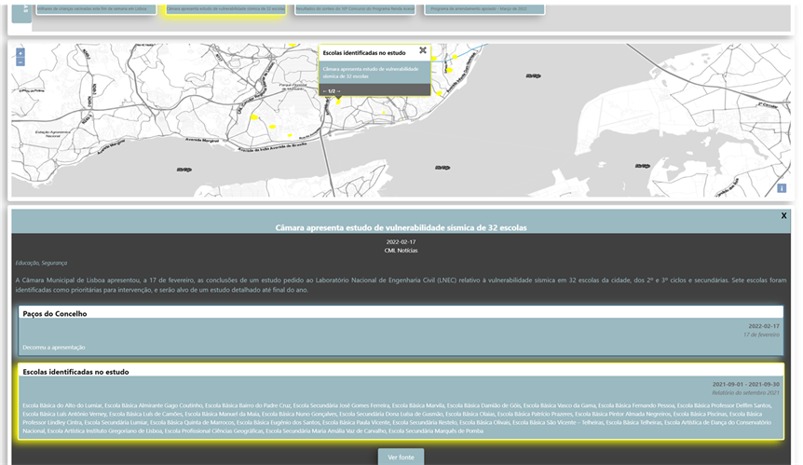
Tools: Explore

Slide 18
Tools: Context
Selected story
Process explore()
Identify story_id, validate, and load
Filters selected
View details of story and associated instances
Identify and load overlap egaz
Explore J Map
Click deets
História
Load pub/area specific explore
Click map
WFS layer,
WFS popup
Identify publication
Load popups w details of all loaded results at click point
Similar area
Identify selected area
Notes:
This is the current working data model. The items in red are expected to be provided by the news data sources.

Slide 19
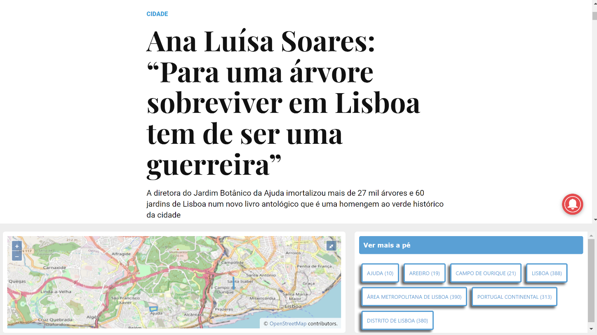
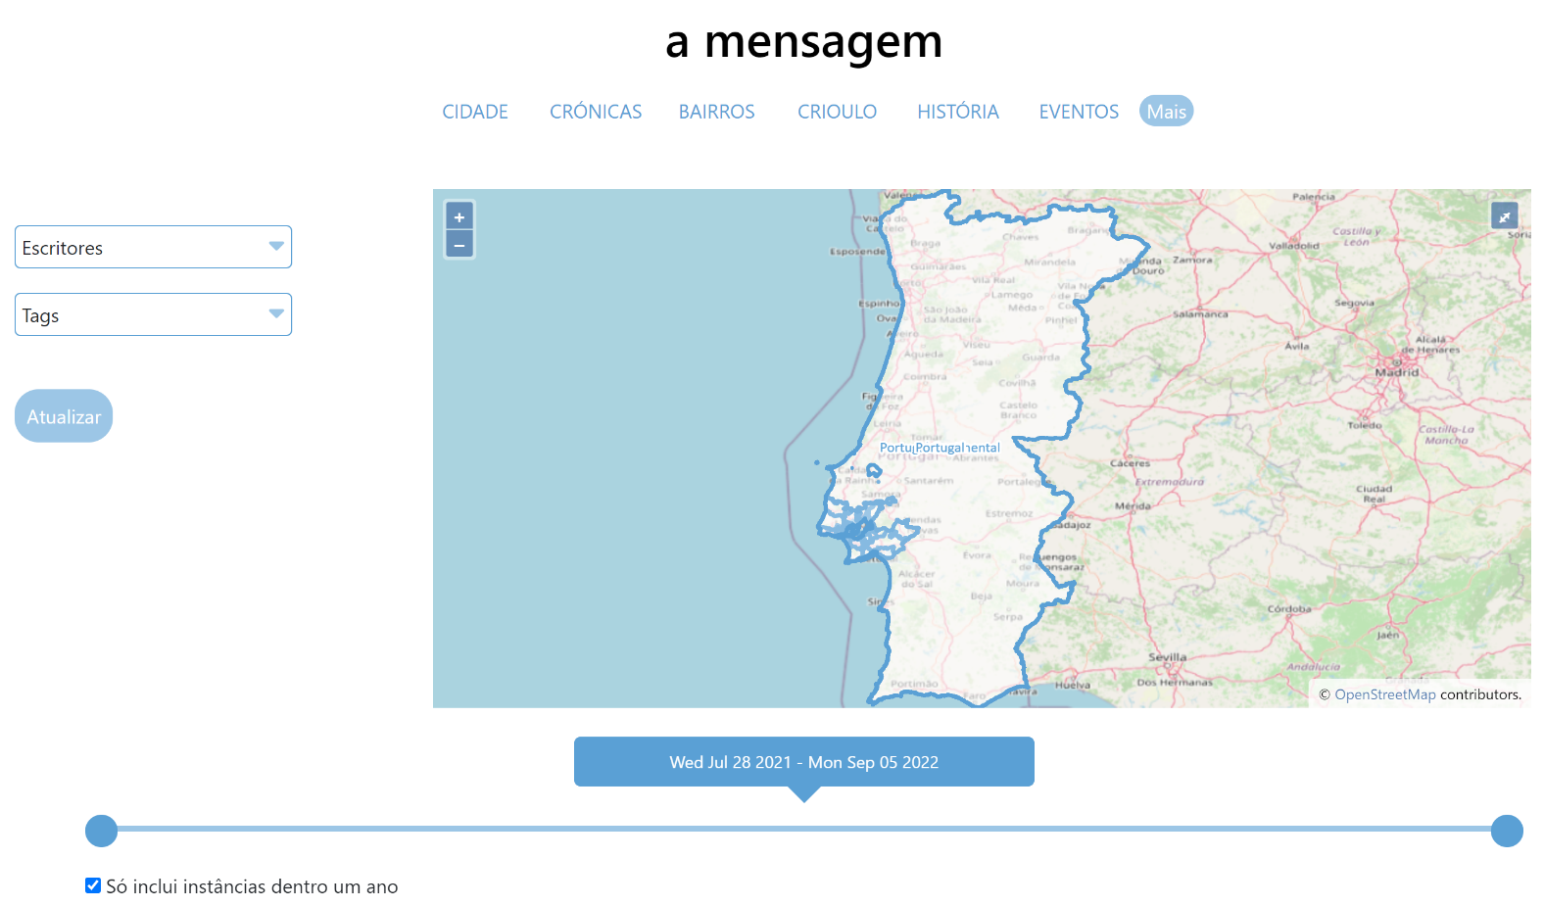
Tools: Explore

Slide 20
Tools: Dashboard
Hotspots
API
Download
Saved searches
Temporal animations
Word association in space: identification of new trends or neighborhoods
Notes:
This is the current working data model. The items in red are expected to be provided by the news data sources.

Slide 21
Report: Outline
Introduction
Literature review
Citizen empowerment
Spatial information
News localization
Web application
Methodology
Justification
Distinction from previous work
Public participation
Nuanced “place”
Knowledge facilitation
Features
Study area
Data
Manipulation
Data Collection
Data preparation & integration
Development
Concept
Model design
Architecture
GIS design
Architecture
Web interface
Front end
Back end
Feedback
Initialization of development environment
Tool design
Testing / Validation
Results
Status
Use cases flow
Future Opportunities
Validation
Application to GeoIntelligence
Sub-article definitions
Recommended extraction of place
Incorporation of historical stories
Statistical Analysis
Dashbord
Conclusion
*Latex in moodle

Slide 22
Questions: Technical
System architecture:
Apache vs. Flask: does it surround Flask (everything goes through Apache) or does Apache rest inbetween the Client and the app and the static files (as pictured)?

Slide 23
Next steps
Feedback: welcome
Roadblocks: time
Report progression: none
Future development plans: lots
Strategy for completion: ?
Presentation:
No live demos – will fail
No movies more than 2 min
Motivation: innovation. Things that didn’t previously exist, support need for the work.
Highlight work during and results
Intro, relevance, methodology (1 or 2 slides), Results and beyond

Slide 24

Thank you!
Discussion
Address: Campus de Campolide, 1070-312 Lisboa, Portugal
Tel: +351 213 828 610 | Fax: +351 213 828 611

